Slide 1

Comparing and Contrasting
Character’s Adventures
Part 1
Mrs. Talley’s Kindergarten
Russell Jones Elementary
February 21, 2012

Slide 2
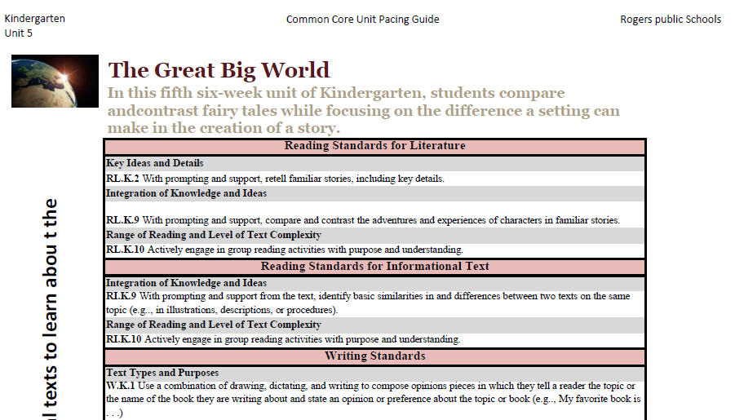
Mrs. Talley began planning the lesson with the kindergarten unit 5 pacing guide. She selected the standard first.
  RL.K.9 With prompting and support, compare and contrast the adventures and experiences of characters in familiar stories.

Slide 3
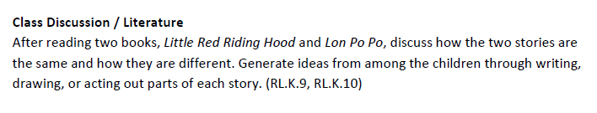
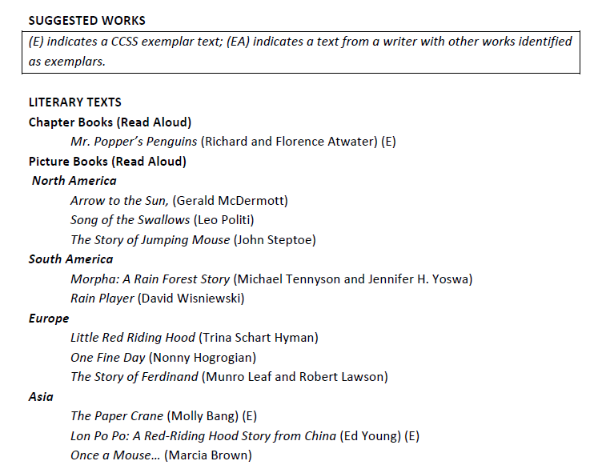
Next, Mrs. Talley selected a suggested activity and
two texts from unit 5 The Great Big World.

Slide 4
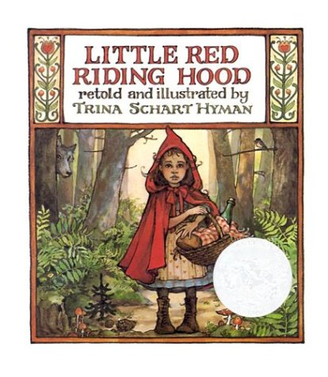
Mrs. Talley knew that before her students could compare and contrast characters’ adventures in familiar stories, she would need to make sure her students understood what an adventure was.
  RL.K.9 With prompting and support, compare and contrast the adventures and experiences of characters in familiar stories.
Prior to this lesson, Mrs. Talley read Little Red Riding Hood to her students.

Slide 5
Writing: Apply strategies, when prompted, to move from oral to written language (ELPW.7.K-2.4)
Writing: Apply strategies, when prompted, to move from oral to written language (ELPW.7.K-2.4)
Because many of her students are language learners, Mrs. Talley planned to incorporate the following language objectives in her lesson:
Language Objectives:
Listening: Listen to literature from diverse cultures (ELPL.1.K-2.8)
Speaking: Respond appropriately- EL1 one or two word phrases, EL2 simple sentences (ELPL.1.K-2.8)
Reading: Answer questions (ELPR.4.K-2.4)
Writing: Apply strategies, when prompted, to move from oral
to written language (ELPW.7.K-2.4)

Slide 6

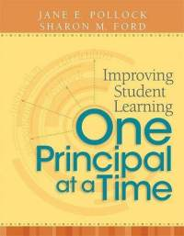
GANAG is a lesson structure that allows teachers to plan for student use of research based instructional strategies.
G= goal
A= access prior knowledge
N= new information
A= application
G= generalize the goal

Slide 7
(2) Identifying Similarities and Differences
(7) Cooperative Learning
(8) Setting Objectives and Providing Feedback
(3) Summarizing and Note Taking
(4) Reinforcing Effort and Providing Recognition
(9) Generating and Testing Hypotheses
(5) Homework and Practice
(10) Cues, Questions and Advance Organizers
(6) Nonlinguistic Representations
GANAG gives students the opportunity to actively use the nine high-yield strategies.

Slide 8

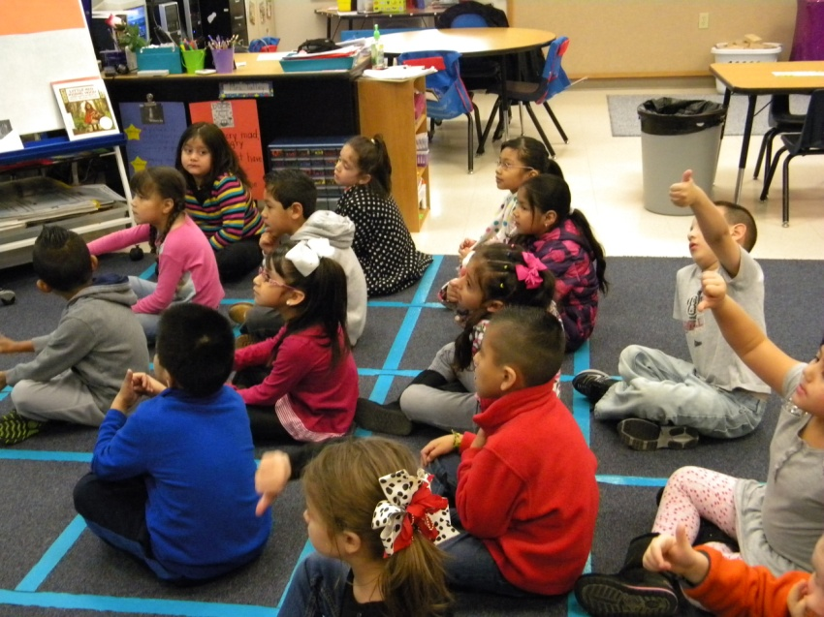
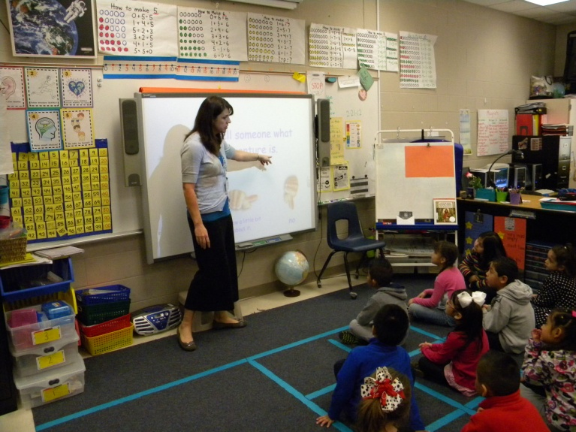
(8) Setting Objectives and Providing Feedback
GOAL: I can tell someone what an adventure is.
Students gathered on the carpet. Each student has an assigned square.
Students scored themselves to the goal with a thumbs up or down.

Slide 9
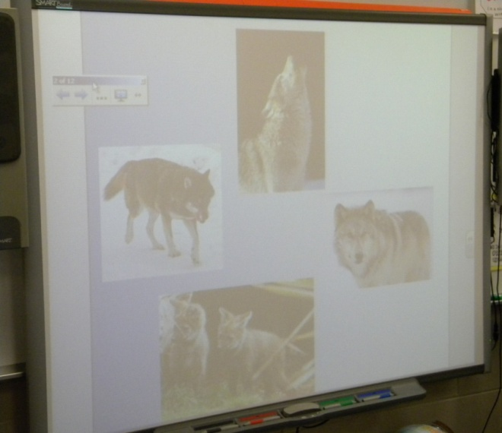
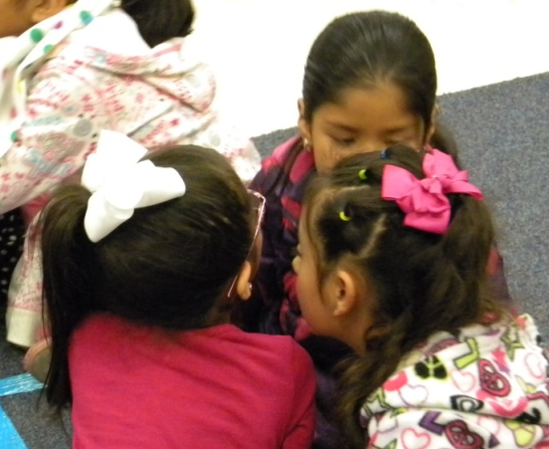
Access Prior Knowledge
Mrs. Talley displayed pictures of wolves on her SmartBoard.
“Turn and Talk to a friend. What do you know about these pictures?”
(6) Nonlinguistic Representations
(10) Cues, Questions and Advance Organizers
(7) Cooperative Learning

Slide 10
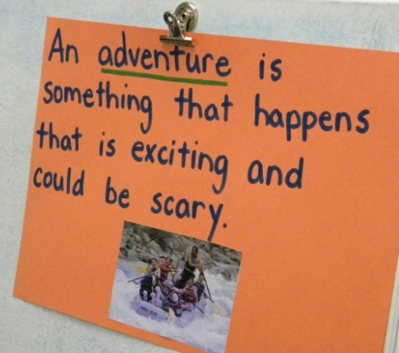
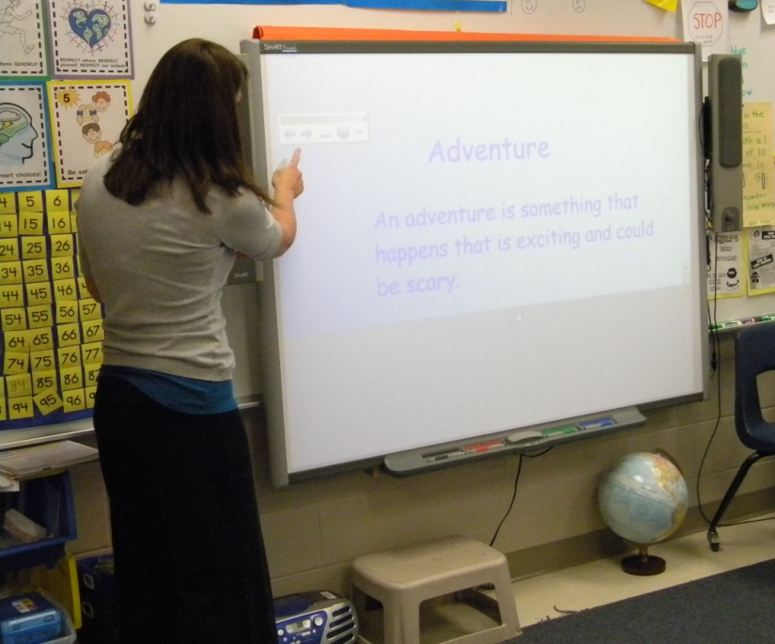
New Information
“Today, we are going to talk about a girl who has an adventure with a wolf!”
The students read the definition of an adventure with Mrs. Talley.

Slide 11
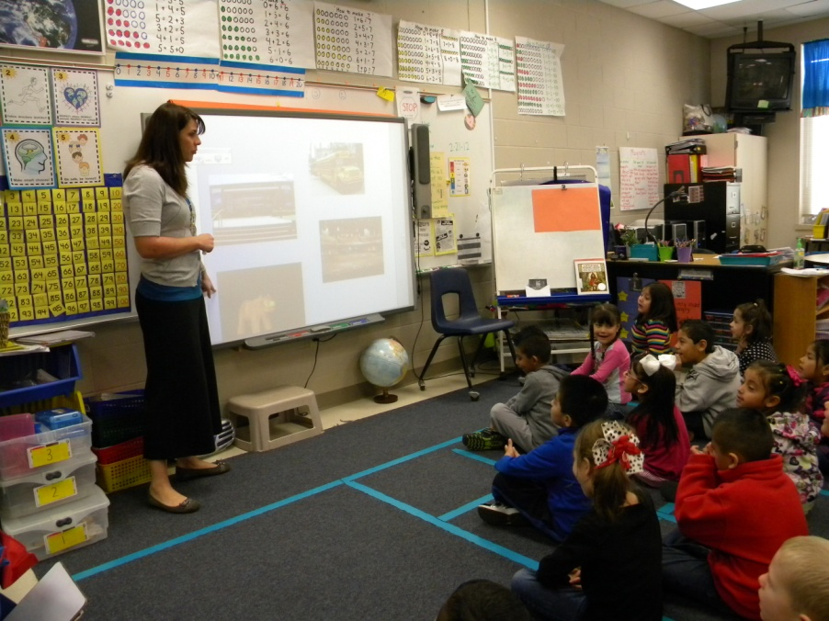
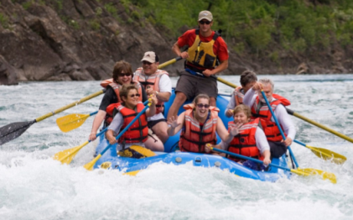
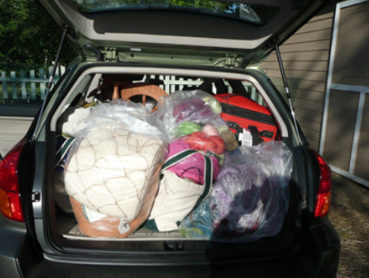
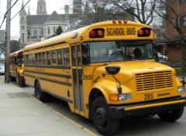
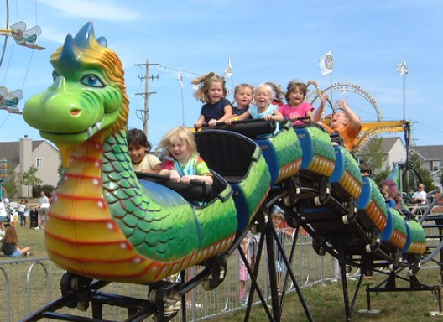
Mrs. Talley shared real life examples of adventures:
Taking a trip
  Driving to Mexico
  Driving to California
  Driving to Texas
Riding a carnival ride
White Water Rafting
Recent field trip (Walton Art Center)
(6) Nonlinguistic Representations

Slide 12
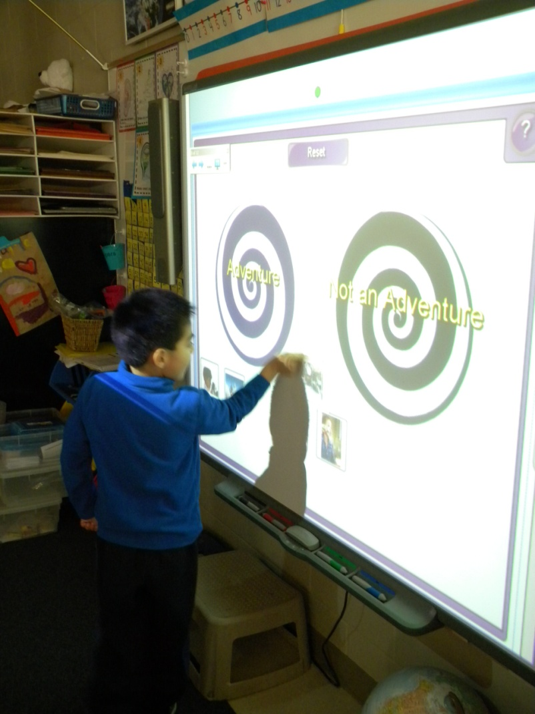
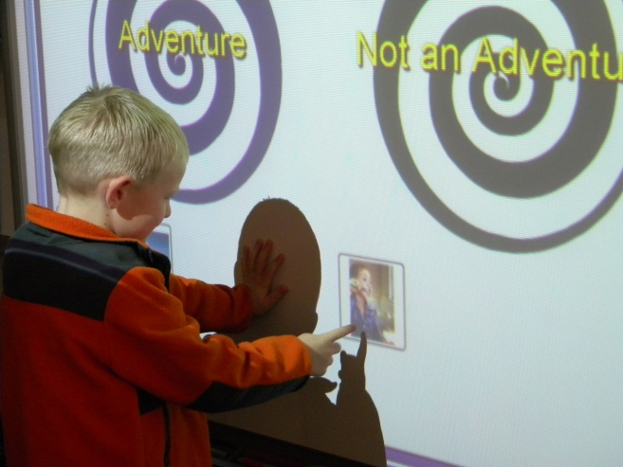
The students played an “Adventure”, “Not an Adventure” sorting game.
“Tell us about your picture before you move it.”
“The boy is brushing his teeth.”
(2) Identifying Similarities and Differences

Slide 13
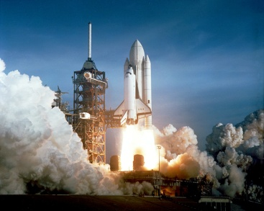
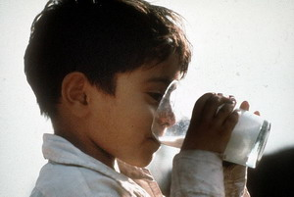
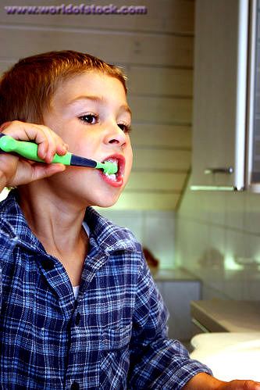
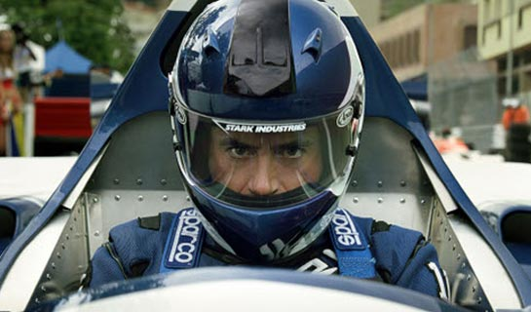
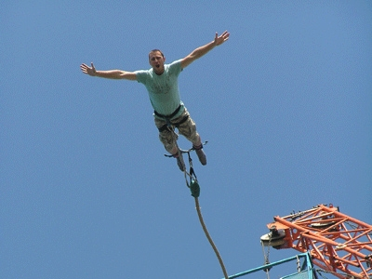
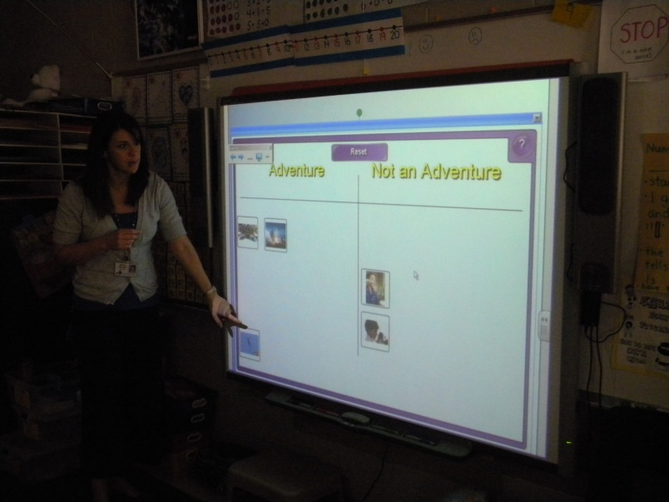
Adventure
Not an Adventure

Slide 14
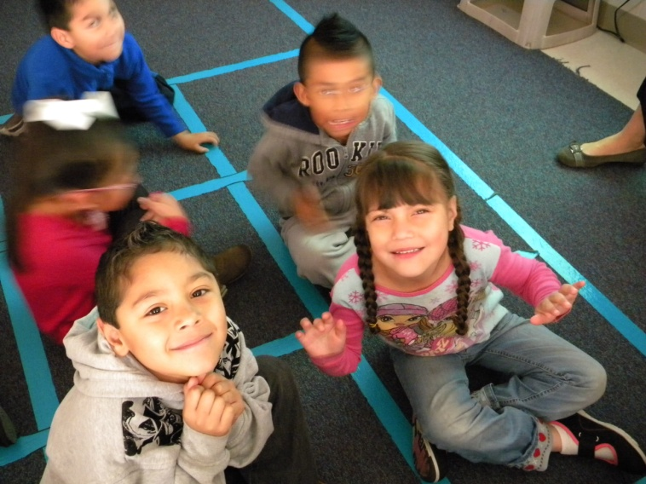
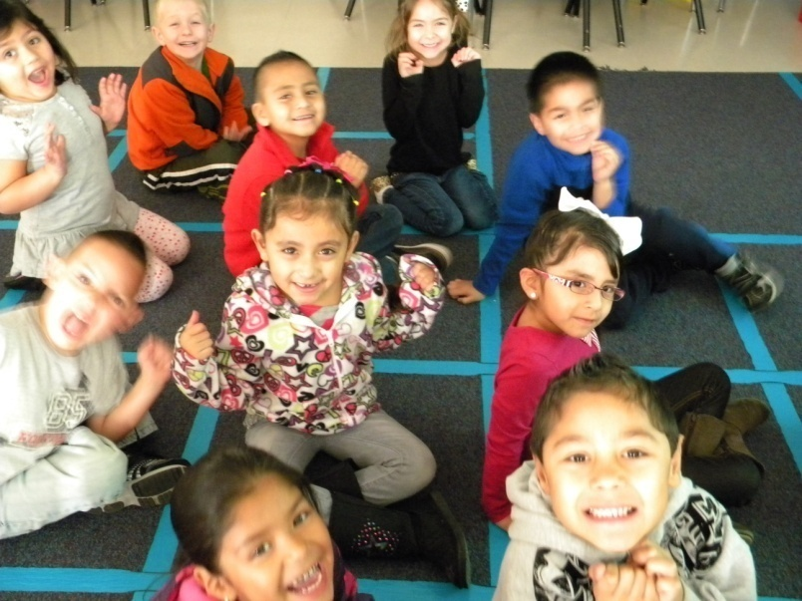
“Show me what it looks like to be excited!”
“Show me what it looks like to be scared!”

Slide 15
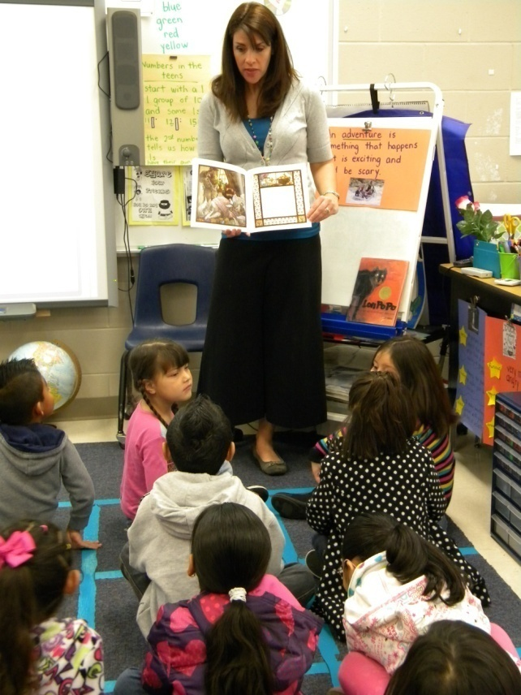
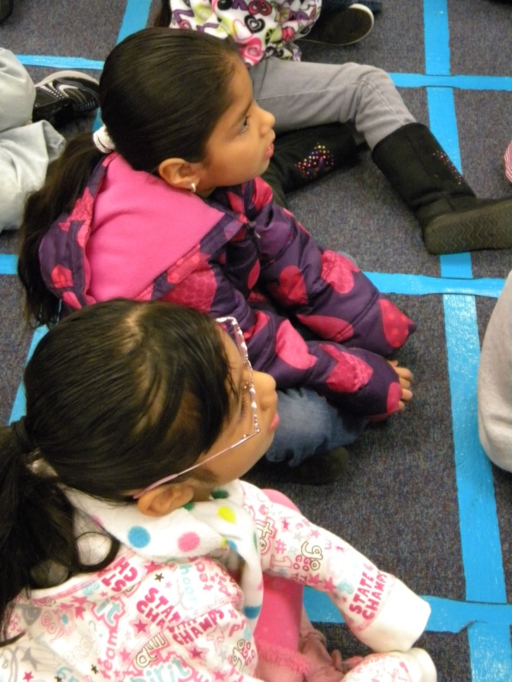
Application
With prompting and support from Mrs. Talley, the class retold the story Little Red Riding Hood.

Slide 16
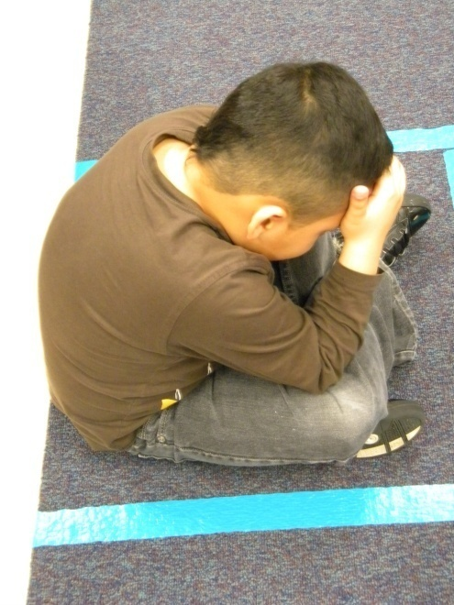
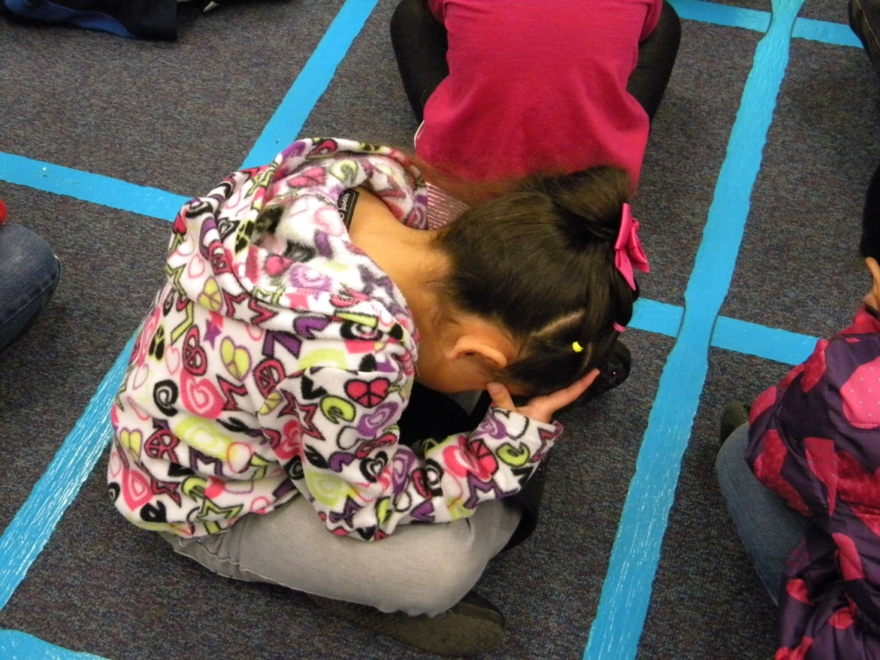
“Close your eyes and think about the story.
What adventure did Little Red Riding Hood have?”

Slide 17
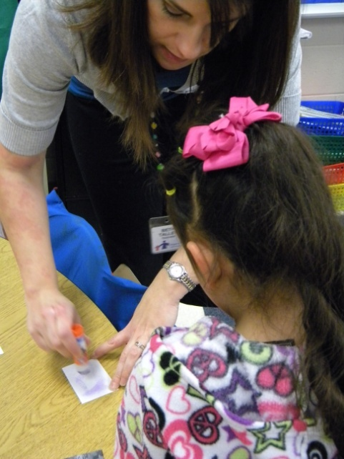
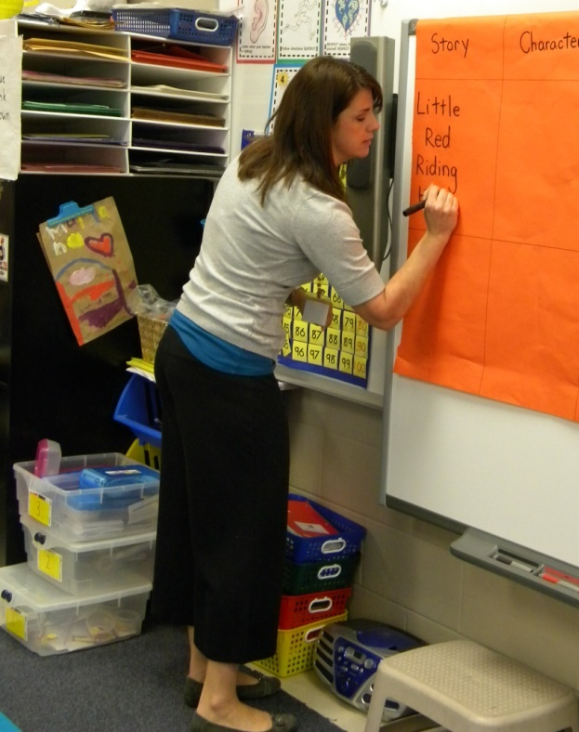
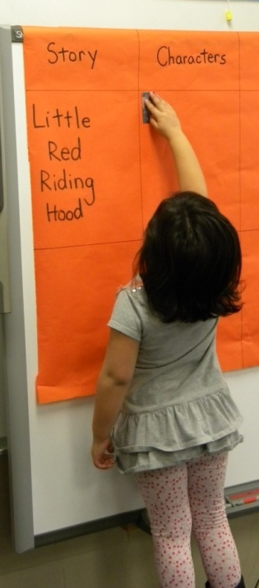
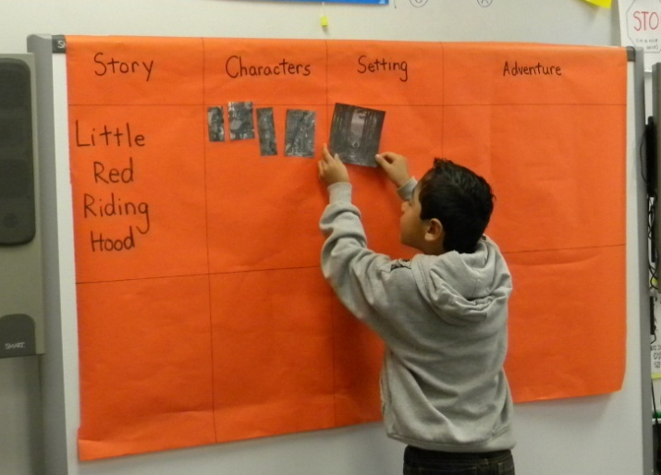
The class began filling out a comparison matrix.
Story
Characters
Setting
Adventure
The students helped Mrs. Talley figure out which letters to write as they composed the labels together. The students wrote letters in the air.
(3) Summarizing and Note Taking

Slide 18
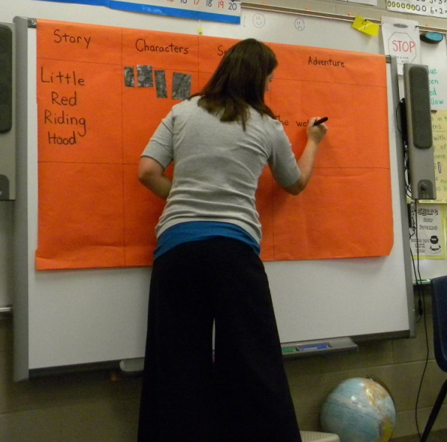
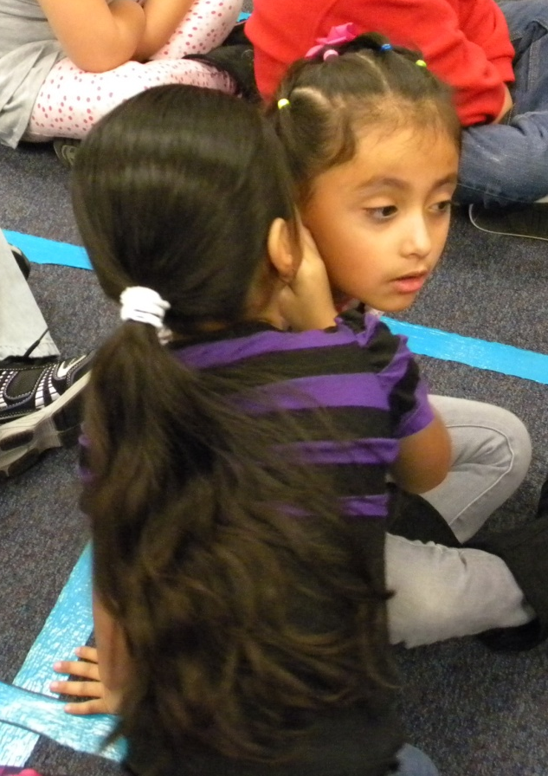
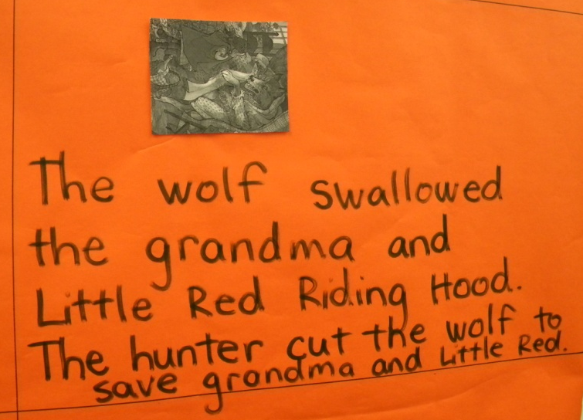
“Turn and talk, what words should we use to write about Little Red Riding Hood’s adventure?”
The students helped Mrs. Talley summarize the adventure.

Slide 19
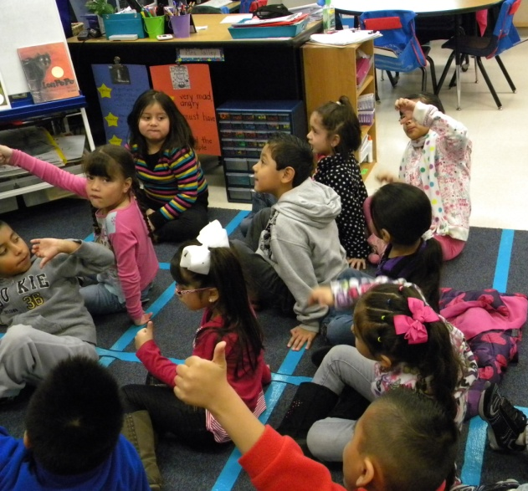
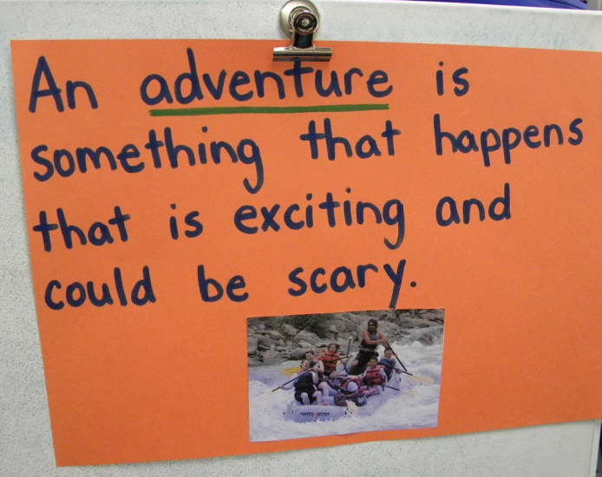
GOAL: I can tell someone what an adventure is.
Students revisited the goal and scored themselves again with a thumbs up or down.
(8) Setting Objectives and Providing Feedback

Slide 20
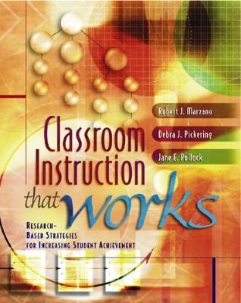
Marzano, R. J., Pickering, D. J., & Pollock, J. E. (2001). Classroom instruction that works: Research-based strategies for increasing student achievement. Alexandria, VA: Association for Supervision and Curriculum Development.
Pollock, J. E. (2007). Improving student learning one teacher at a time. Alexandria, VA: Association for Supervision and Curriculum Development.
Pollock, J. E., & Ford, Sharon M. (2009). Improving student learning one principal at a time. Alexandria, VA: Association for Supervision and Curriculum Development.

